Slide 1

SMART CLASSROOM AUTOMATION SYSTEM

Slide 2
ABSTRACT
The Smart Classroom Automation System is an IoT-based automation project developed using an STM32 microcontroller to improve energy efficiency and classroom comfort. The system monitors classroom conditions using a PIR sensor, LDR sensor, and temperature sensor. The PIR sensor detects the presence of people, the LDR measures the surrounding light intensity, and the temperature sensor monitors the room temperature.
Based on the sensor readings, the STM32 automatically controls classroom lights and fans. An LCD displays real-time environmental information, while a Wi-Fi module can transmit monitoring and power-consumption information to a remote system. The system reduces unnecessary power consumption by operating electrical appliances according to actual classroom conditions.

Slide 3
INTRODUCTION
Traditional classrooms depend largely on manual control of lights and fans.
Lights and fans may remain ON even when they are not required.
Manual operation can lead to unnecessary energy consumption.
Classroom conditions such as occupancy, light, temperature, and humidity can be monitored automatically.
The proposed system uses STM32 and sensors to automate classroom appliances.
ESP32 provides Wi-Fi connectivity for monitoring and IoT functionality.

Slide 4
PROBLEM STATEMENT
Traditional classrooms often depend on manual control of lights and fans. This can result in:
Lights remaining ON when sufficient natural light is available.
Fans operating when the classroom is empty.
Electrical appliances being left ON after students leave.
Lack of real-time monitoring of classroom conditions.
Unnecessary electricity consumption.
Difficulty in monitoring classroom energy usage remotely.
Therefore, an automated system is required to monitor classroom conditions and control electrical appliances intelligently.
Proposed Sensors
PIR Sensor — detects human presence
LDR Sensor — measures light intensity
DHT11 Sensor — measures temperature and humidity
Proposed Platform
STM32 — main control and processing platform
ESP32 — Wi-Fi and IoT communication
Display Module — real-time status display

Slide 5
OBJECTIVES
The main objectives are:
To detect classroom occupancy using a PIR sensor.
To measure ambient light intensity using an LDR sensor.
To monitor classroom temperature using a temperature sensor.
To automatically control lights according to occupancy and brightness.
To automatically control fans according to temperature.
To display sensor readings on an LCD.
To transmit monitoring/power information using a Wi-Fi module.
To reduce unnecessary electricity consumption.
To improve classroom comfort and automation.

Slide 6
FINAL SYSTEM OVERVIEW
The system follows the following process:
Sensors → STM32 → Decision Making → Appliance Control → LCD/Wi-Fi Monitoring
Working sequence
The system starts and initializes the STM32 peripherals.
The PIR sensor checks whether people are present.
The LDR sensor measures the brightness level.
The temperature sensor measures the room temperature.
STM32 processes the sensor readings.
If people are detected and the room is dark, the lights are switched ON.
If the temperature exceeds the defined threshold, the fan is switched ON.
If the classroom is empty, unnecessary appliances are switched OFF.
The LCD displays the current environmental conditions.
The Wi-Fi module can send monitoring information to a remote system.

Slide 7
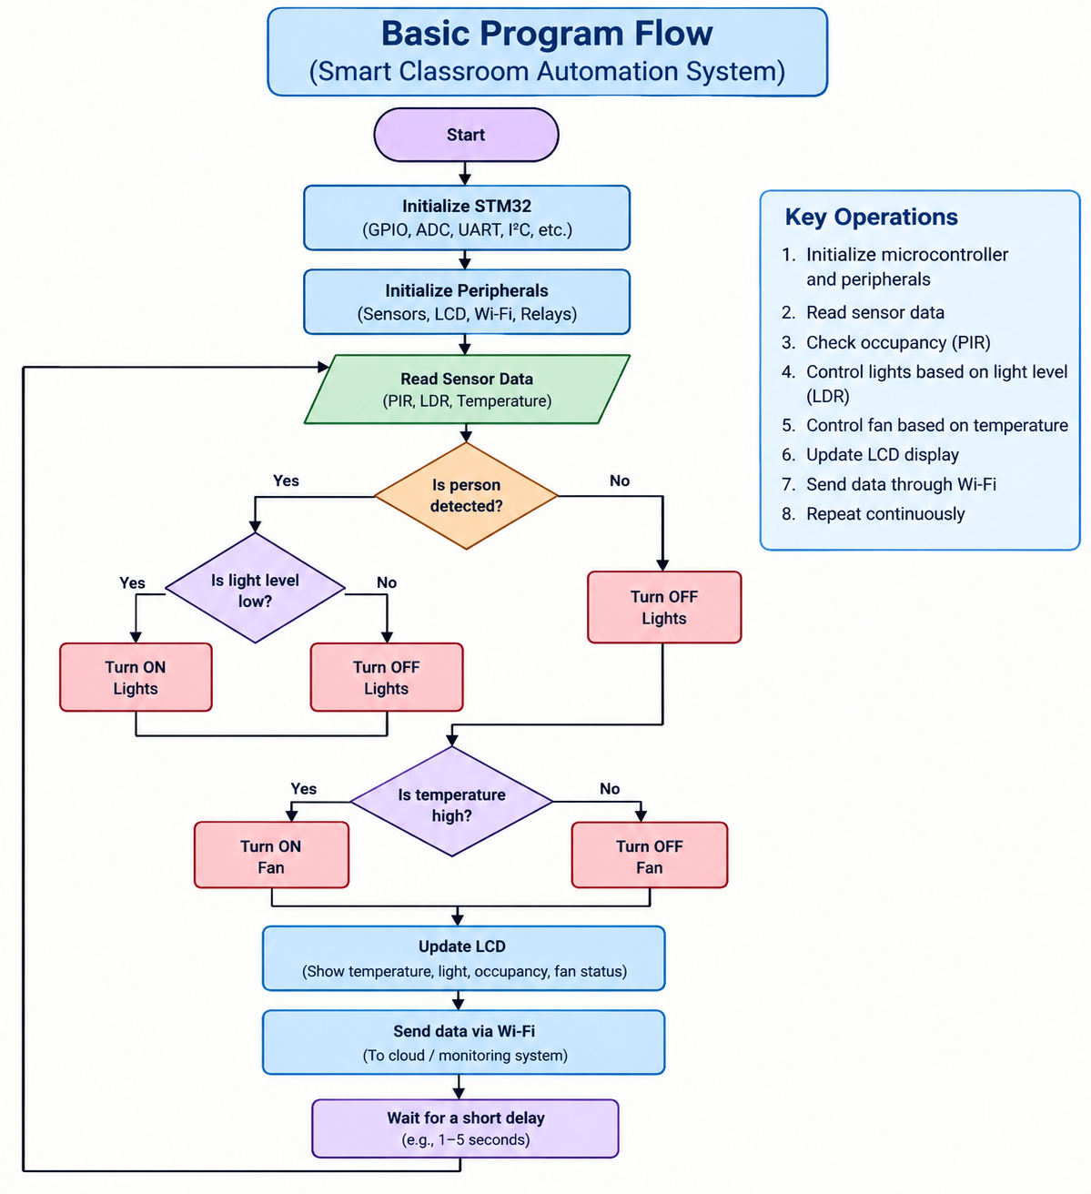

Slide 8
MAJOR COMPONENTS
Component | Function
STM32 | Main microcontroller
PIR Sensor | Detects human presence
LDR | Measures light intensity
DHT11/Temperature Sensor | Measures temperature
Relay Module | Controls lights/fans
LCD | Displays sensor information
Wi-Fi Module | Remote communication
Power Supply | Provides required power
LEDs/Lamp | Represents classroom lighting
Fan | Provides temperature control

Slide 9
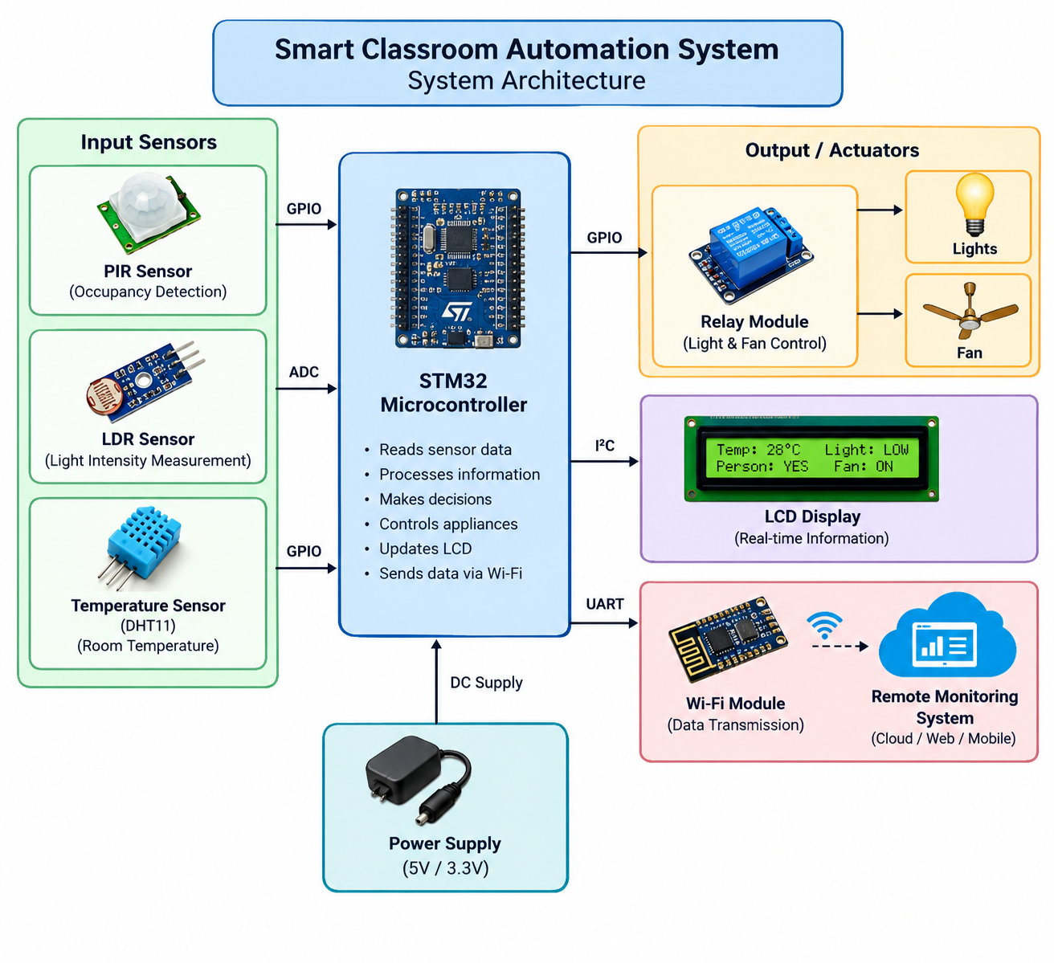

Slide 10
CORE FEATURES IMPLEMENTED
1. Automatic Occupancy Detection
The PIR sensor detects movement/presence inside the classroom.
2. Automatic Light Control
The LDR measures the brightness of the room.
3. Automatic Fan Control
The temperature sensor provides the classroom temperature.
4. LCD Monitoring
The LCD can display:
Temperature: 28°C
Light: LOW
Person: YES
Fan: ON
Light: ON
5. Wi-Fi Monitoring
The Wi-Fi module provides communication between the STM32 system and a remote monitoring application/server.
Information that can be transmitted includes:
Temperature
Occupancy status
Light status
Fan status
Power usage/energy information

Slide 11
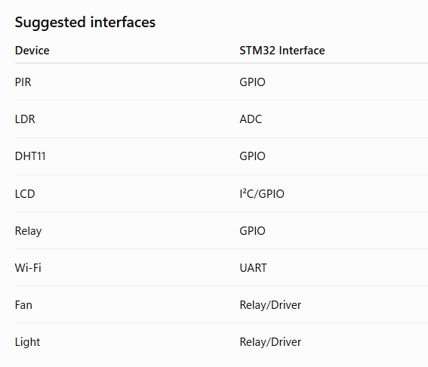
TECHNICAL IMPLEMENTATION
1. Hardware Implementation
The STM32 is the central controller of the system.
The sensors are connected to appropriate STM32 GPIO/ADC/interface pins.
2. Software Implementation
The software can be developed using:
STM32CubeIDE
STM32 HAL Library
Embedded C
STM32CubeMX configuration
ST-LINK debugger/programmer

Slide 12
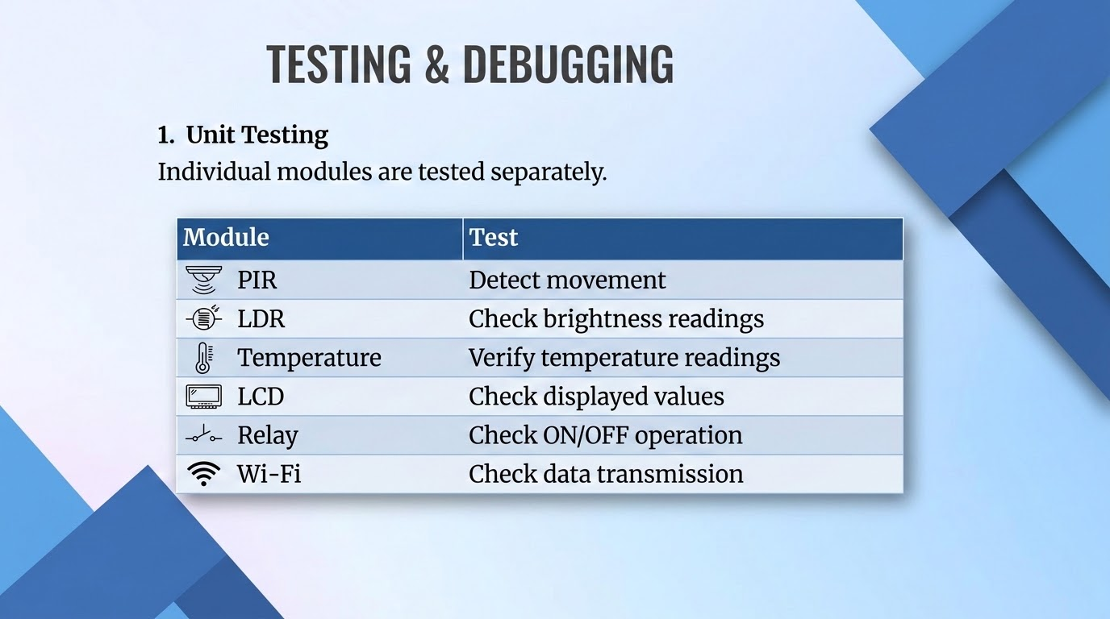

Slide 13
2. Integration Testing
After individual testing, all components are connected together.
For example:
PIR + LDR + STM32 + Relay + Light
Then: Temperature Sensor + STM32 + Relay + Fan
Finally: All Sensors + STM32 + LCD + Wi-Fi + Appliances
3. Debugging Tools
STM32CubeIDE debugger
ST-LINK
Serial/UART monitor
STM32CubeMX
LED indicators

Slide 14
4. Test Results
Test Case | Expected Result | Result
Person enters classroom | PIR detects presence | Pass
Classroom is dark | Light turns ON | Pass
Classroom has sufficient light | Light remains OFF | Pass
Temperature exceeds threshold | Fan turns ON | Pass
Temperature decreases | Fan turns OFF | Pass
Sensor data changes | LCD updates | Pass
Wi-Fi connected | Data transmitted | Pass

Slide 15
CHALLENGES & SOLUTIONS
Challenge | Solution
Sensor readings were inconsistent | Checked wiring, power supply and sensor configuration
Difficulty configuring STM32 pins | Used STM32CubeMX/CubeIDE GPIO configuration
DHT11 communication issues | Implemented correct timing and GPIO configuration
Relay not switching correctly | Checked relay power and GPIO output
LCD not displaying data | Verified I²C connections/address and initialization
Wi-Fi communication problems | Checked UART configuration and baud rate
Debugging embedded code | Used ST-LINK and STM32CubeIDE debugger
Unwanted appliance switching | Added suitable sensor thresholds and control logic

Slide 16
CONCLUSION & OUTCOMES
The Smart Classroom Automation System successfully demonstrates how an STM32-based IoT system can be used to automate classroom appliances and monitor environmental conditions.
The integration of PIR, LDR, and temperature sensors enables the system to make decisions based on occupancy, lighting conditions, and temperature. Automatic control of lights and fans helps reduce unnecessary energy consumption while maintaining a comfortable classroom environment.
The LCD provides local monitoring, while Wi-Fi connectivity provides the possibility of remote monitoring and energy-management applications.

Slide 17
FUTURE WORKS
Mobile App: Remote monitoring and control of classroom devices.
Cloud Integration: Store and analyze sensor and energy data.
Energy Monitoring: Measure real-time electricity consumption.
Smart Fan Control: Adjust fan speed based on temperature.
Notifications: Alerts for high temperature or unnecessary power usage.
Multi-Classroom Support: Connect multiple classrooms to one monitoring system.

Slide 18
THANK YOU

